Slide 1
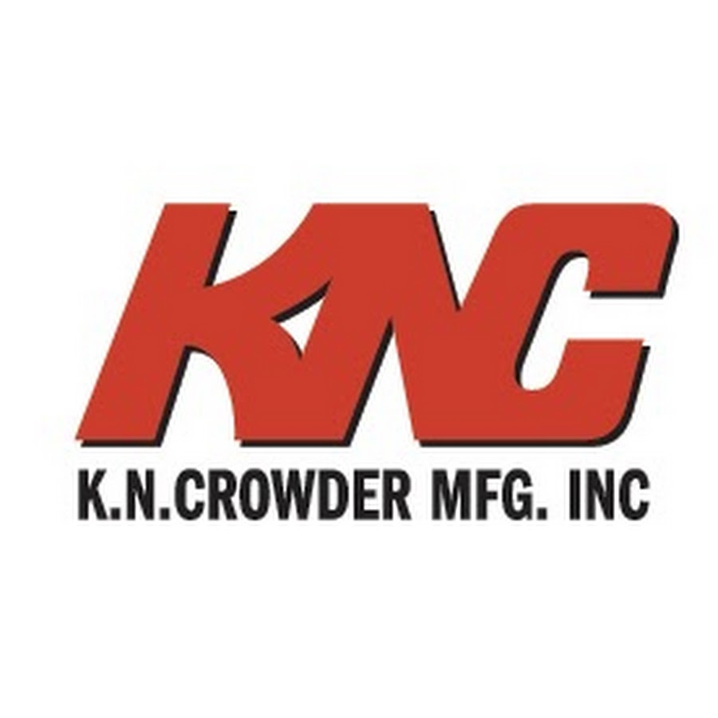

Slide 2
Canadian Manufacturer since the late 1940’s
Family owned and operated
Manufacturer of:
Sliding door track and hardware
Weatherstripping
Thresholds
Automatic door bottoms
Door locks, pulls and louvres
Foot Grilles
Stair nosings

Slide 5
Sliding Door Track and Hardware Considerations
-Top mounted
-Side mounted
-Bi-Parting
-Bi-Folding
-Bypassing
-Pocket Doors
-Exposed Hardware
-Door weight?

Slide 13
https://youtu.be/4kxaLkZcrDc

Slide 14
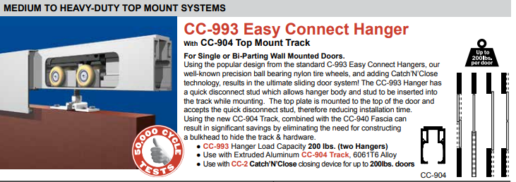
Top Mounted

Slide 15
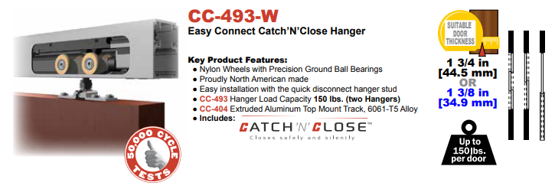

Slide 20
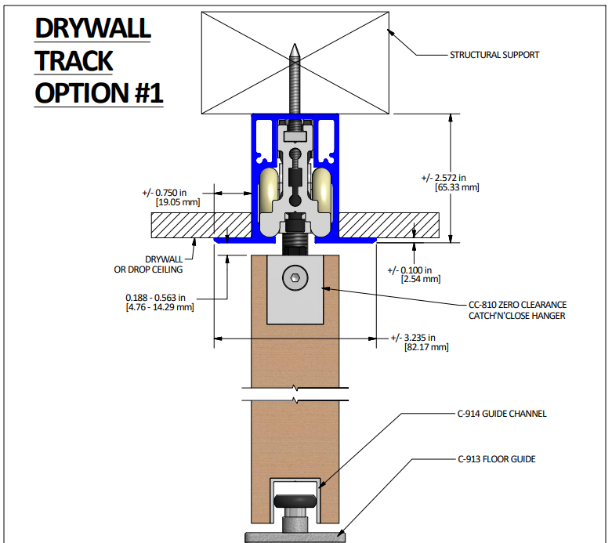

Slide 21
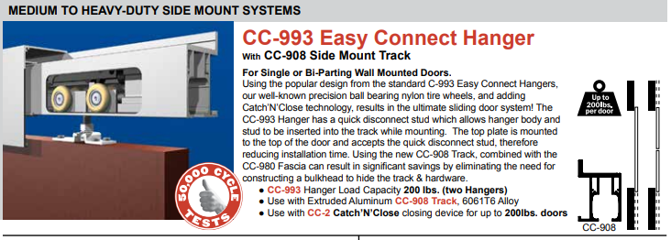
Side Mounted (Barn Door)

Slide 22
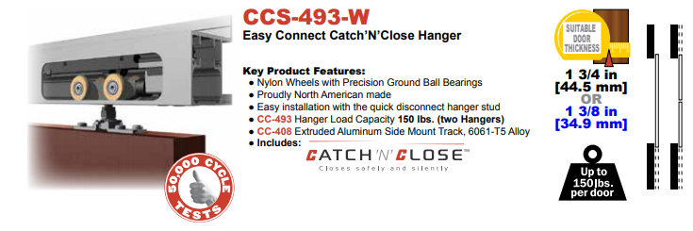

Slide 25
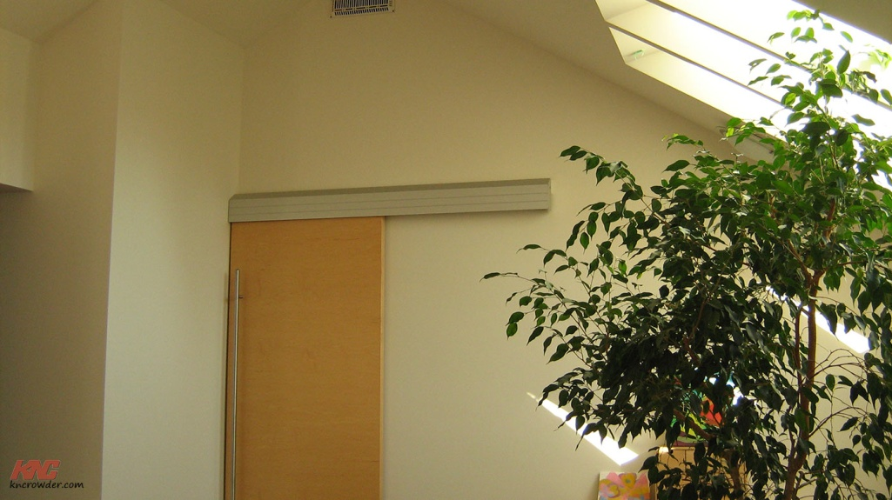
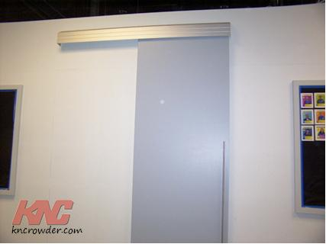

Slide 27
By-Passing

Slide 29
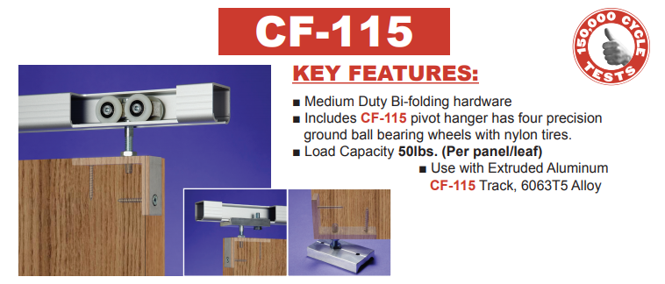
Bi-Fold / Pivot Systems

Slide 31
Pocket Doors

Slide 34
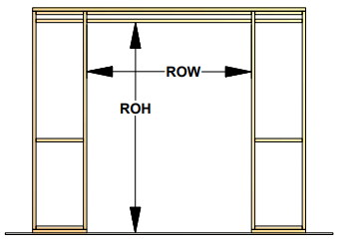
Door size? (extra height and width modifications) up to 4’ X 10’

Slide 38
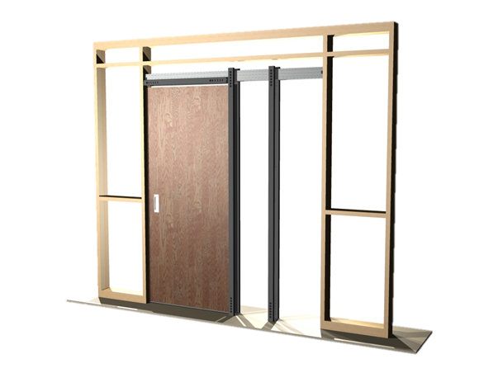
TYPE HD (HEAVY DUTY)
POCKET DOOR KITS
▪Taking our legendary Crowderframe Pocket Door Kits to the next level!
▪Full 2x6 wall construction pocket door kits c/w stronger uprights,
header track & hangers
▪Increasing door weight capacity to 200-300lbs!
▪Will be released with two versions:
–TYPE HD
TYPE HD-CC with Catch’N’Close

Slide 42
Considerations

Slide 43
Installation
https://youtu.be/4Z5MfXWPSSA

Slide 45
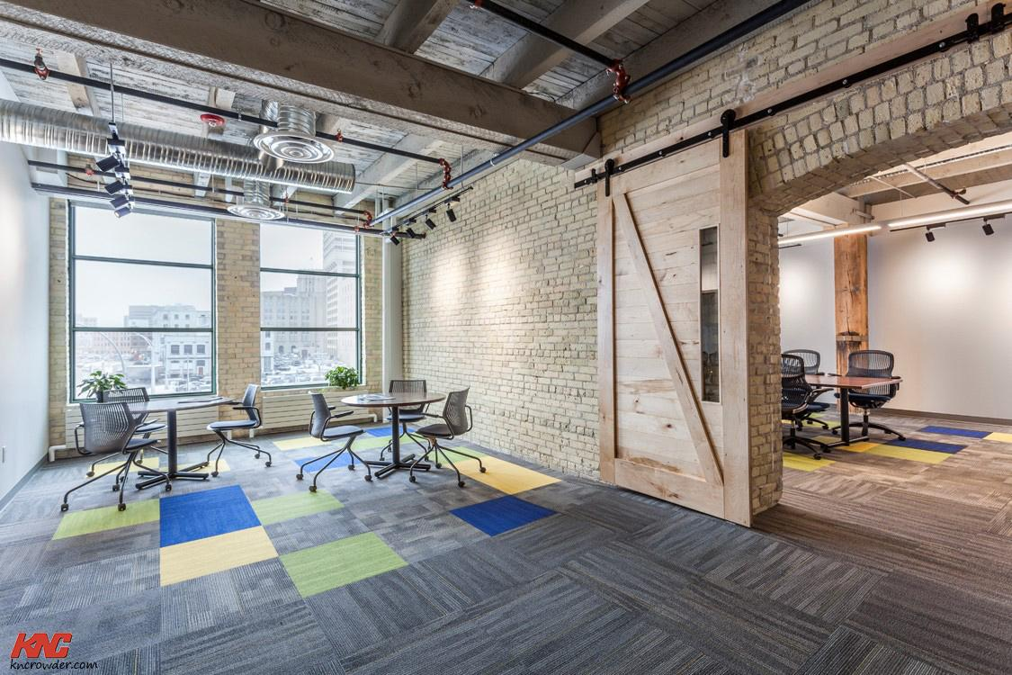
Architecture & Design

Slide 49
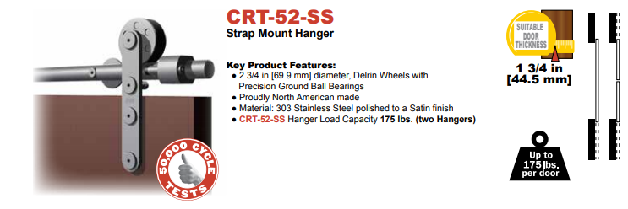

Slide 54
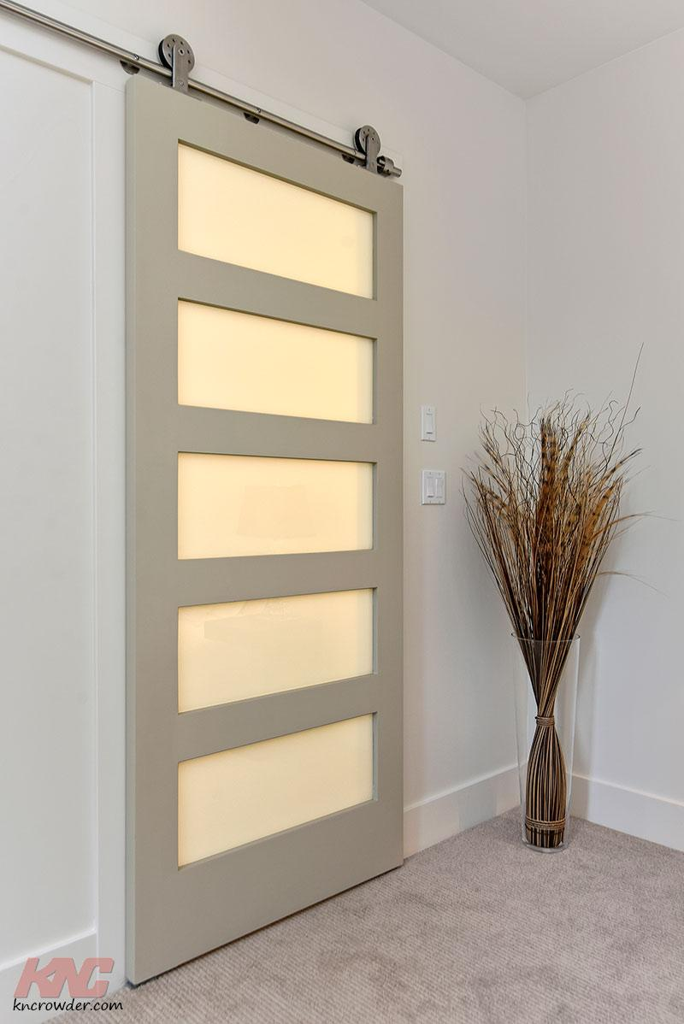

Slide 65
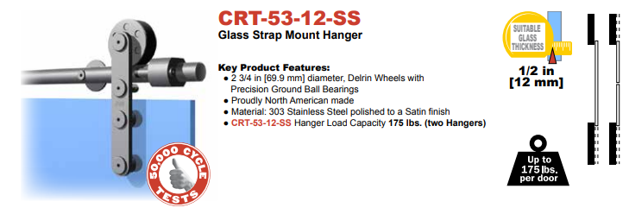
Glass Systems

Slide 72
Custom Systems

Slide 80
Come Along System with Catch N Close video link https://www.youtube.com/watch?v=COoUDucPyAQ

Slide 91
Door Locks and Pulls

Slide 96
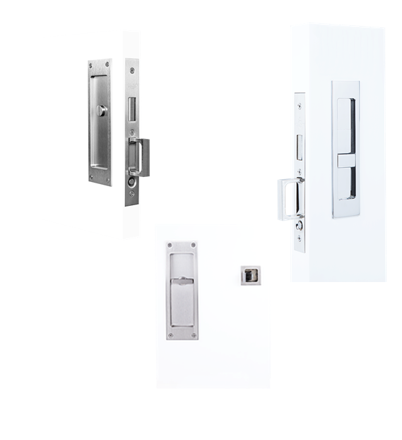
NEW ADDITIONS TO LOCKS & PULLS
▪New slow release Edge Pulls on
C-90L, C-90S & C-91 lock & pull
bodies for quieter operation
▪New vertical operating thumb turn
flush pulls for a cleaner look and
easier to use
▪Barn Door Strike Lock Box
▪Barn Door Locks
(C-94BL Barn Door Lock is available now!)

Slide 98
How to Specify?

Slide 100
Foot Grilles

Slide 103
Thank You! www.kncrowder.com

